Slide 1

MUSIC STORE DATA ANALYSIS
SQL PROJECT

Slide 2
Objective
  Determine the senior-most employee based on job titles.
  Identify countries with the most invoices to understand market reach.
  Find the top values of total invoices to gauge significant sales figures.
  Discover the city with the highest total invoice sum to plan promotional events.
  Identify the best customer based on spending to reward loyalty.

Slide 3
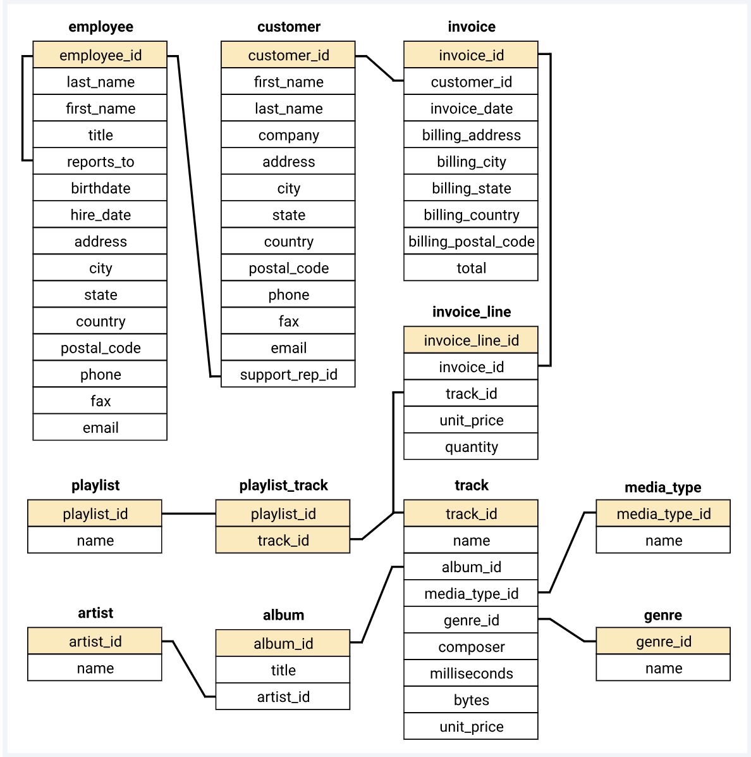
schema

Slide 4
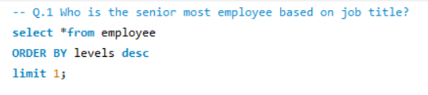
Q.1. Who is the senior most employee based on job title?

Slide 5
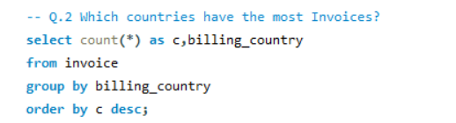
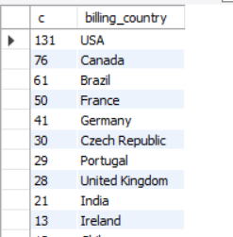
Q.2 Which countries have the most Invoices?

Slide 6
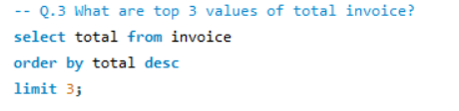
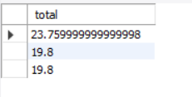
Q.3 What are top 3 values of total invoice?

Slide 7
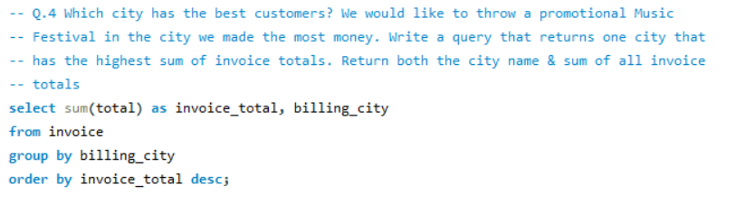
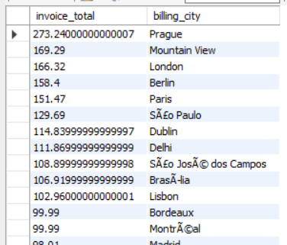
Q.4 Which city has the best customers? We would like to throw a promotional Music
Festival in the city we made the most money. Write a query that returns one city that has the highest sum of invoice totals. Return both the city name & sum of all invoice totals

Slide 8
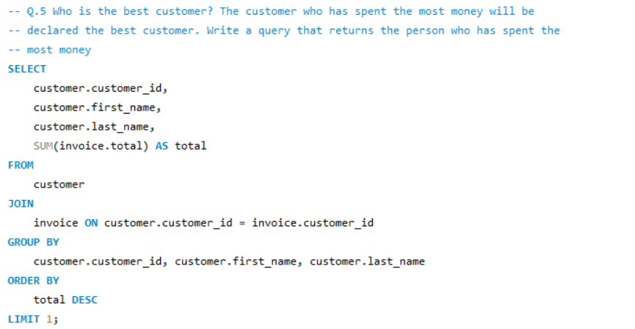

Q. 5 Who is the best customer? The customer who has spent the most money will be declared the best customer. Write a query that returns the person who has spent the most money

Slide 9
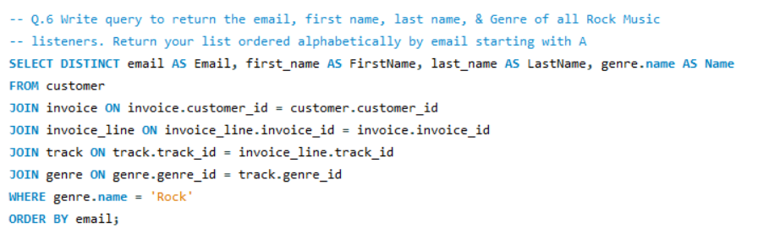
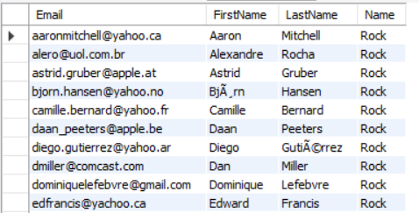
Q. 6 Write query to return the email, first name, last name, & Genre of all Rock Music listeners. Return your list ordered alphabetically by email starting with A

Slide 10
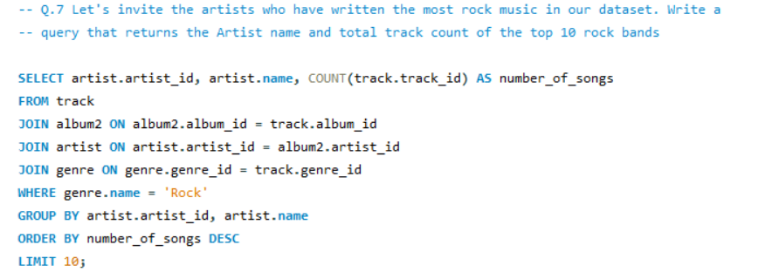
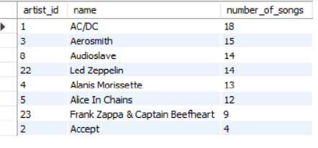
Q.7 Let's invite the artists who have written the most rock music in our dataset. Write a query that returns the Artist name and total track count of the top 10 rock bands

Slide 11
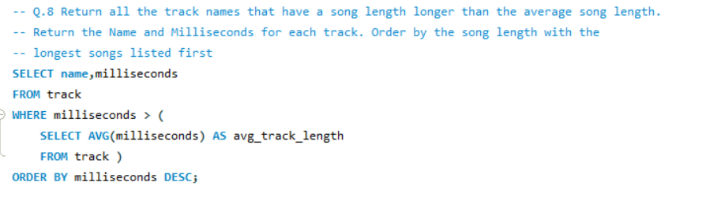
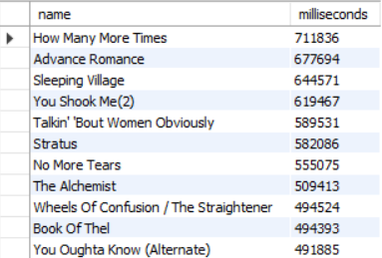
Q.8 Return all the track names that have a song length longer than the average song length.
Return the Name and Milliseconds for each track. Order by the song length with the longest songs listed first

Slide 12
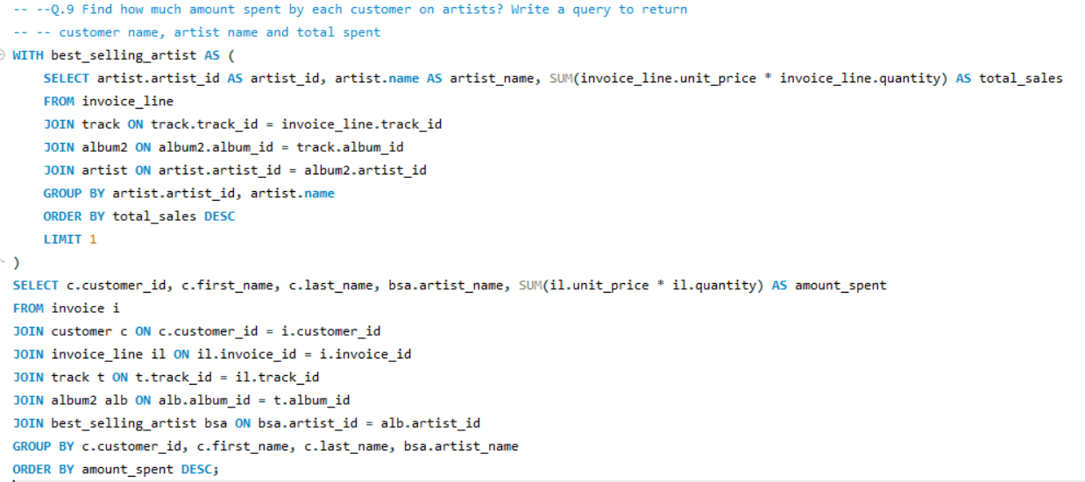
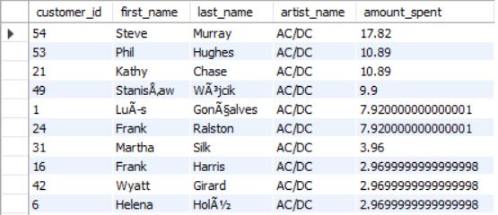
Q.9 Find how much amount spent by each customer on artists? Write a query to return customer name, artist name and total spent

Slide 13
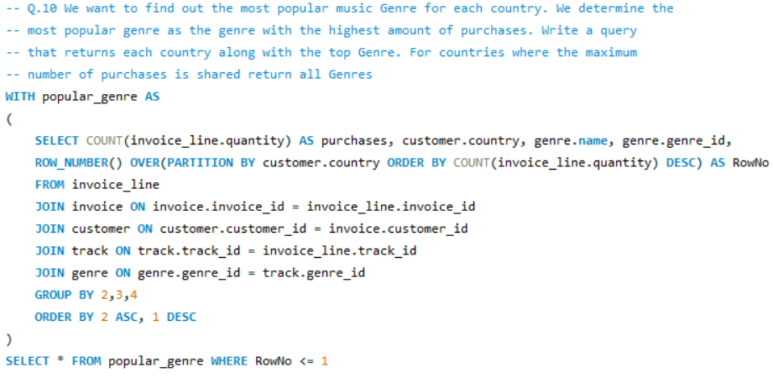
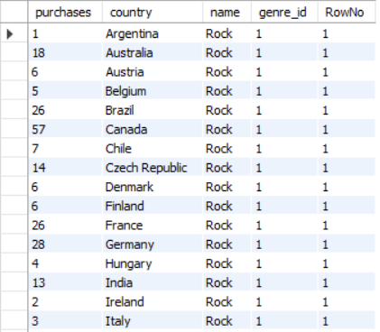
Q.10 We want to find out the most popular music Genre for each country. We determine the most popular genre as the genre with the highest amount of purchases. Write a query that returns each country along with the top Genre. For countries where the maximum number of purchases is shared return all Genres

Slide 14
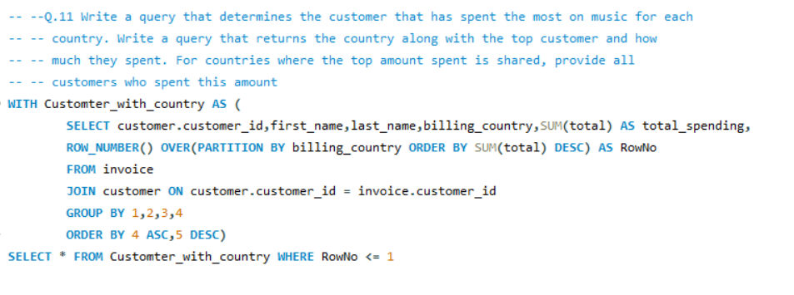
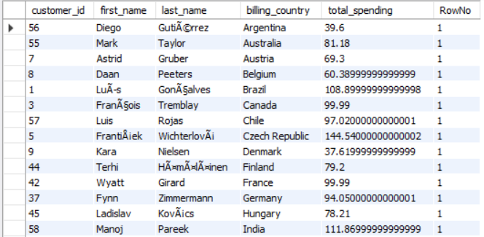
Q.11 Write a query that determines the customer that has spent the most on music for each country. Write a query that returns the country along with the top customer and how much they spent. For countries where the top amount spent is shared, provide all customers who spent this amount

Slide 15
Conclusion
The "Music Store Data Analysis" project has provided valuable insights into various aspects of the music store's operations, customer behavior, and sales trends. By leveraging SQL queries, we were able to answer critical business questions, which can now inform strategic decision-making processes.

Slide 16
Thank you !!!

